Slide 1
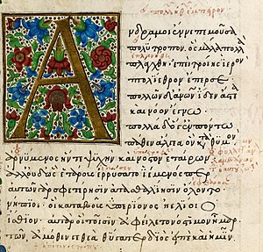
Homer’s
Odyssey

Slide 2
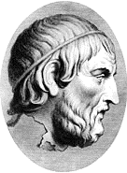
Homer’s Odyssey
Odyssey means a Narrative Poem about a journey
The Greek word Aoidos referred to a classical
Greek singer.
Rhapsode (Greek: ῥαψῳδός, "rhapsōidos"),
Rhapsodist, refers to a classical Greek
professional performer of epic poetry.
The Greek poet Homer was born sometime between the 12th and 8th centuries BC, possibly somewhere on the coast of Asia Minor. He is famous for the epic poems The Iliad and The Odyssey.

Slide 3
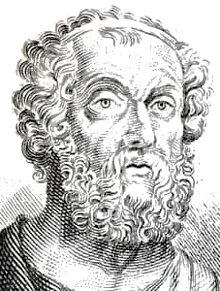
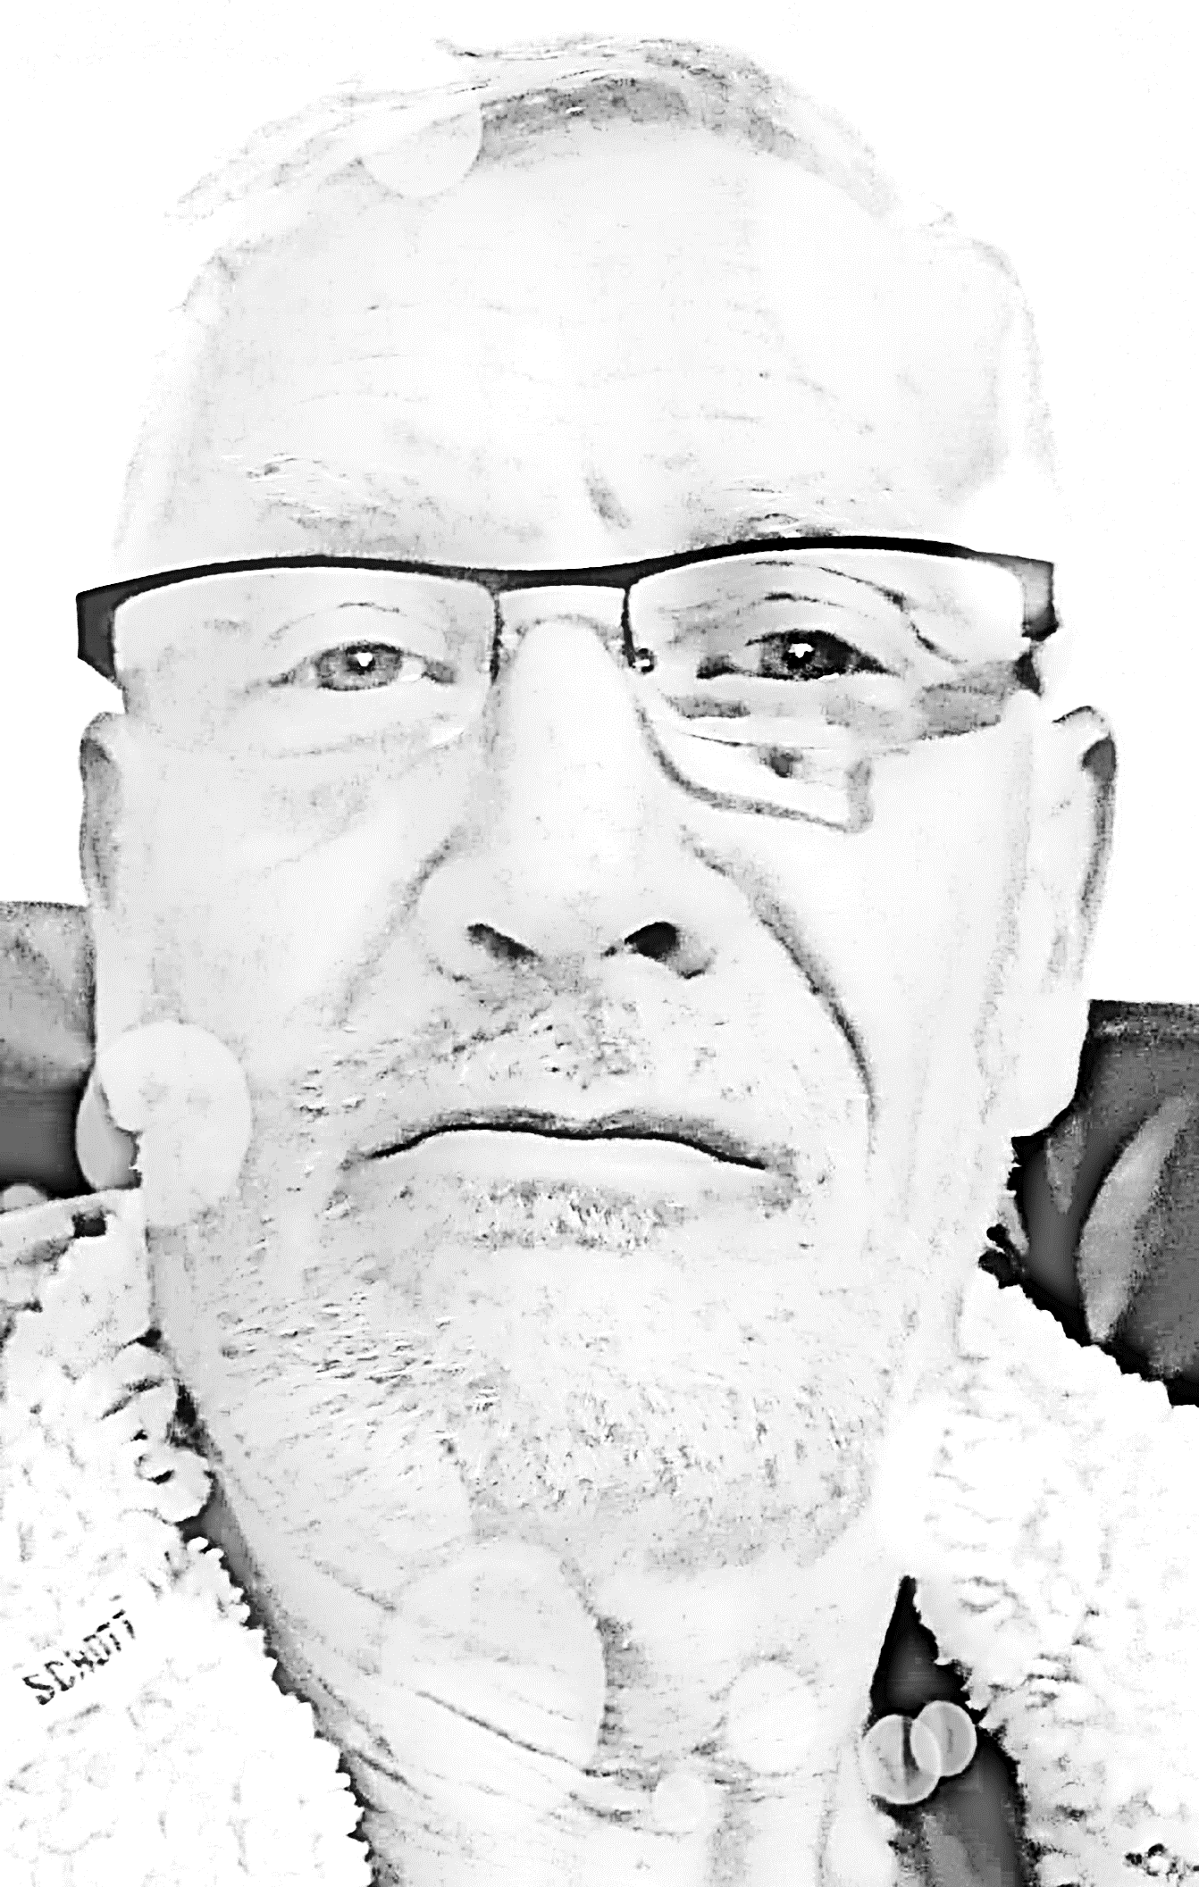
Poets
Storytellers
Writers
Authors
Performers
Homer
Dave

Slide 4
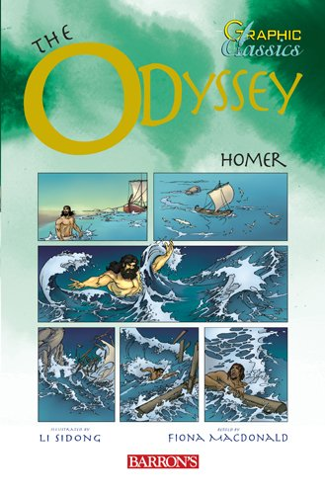
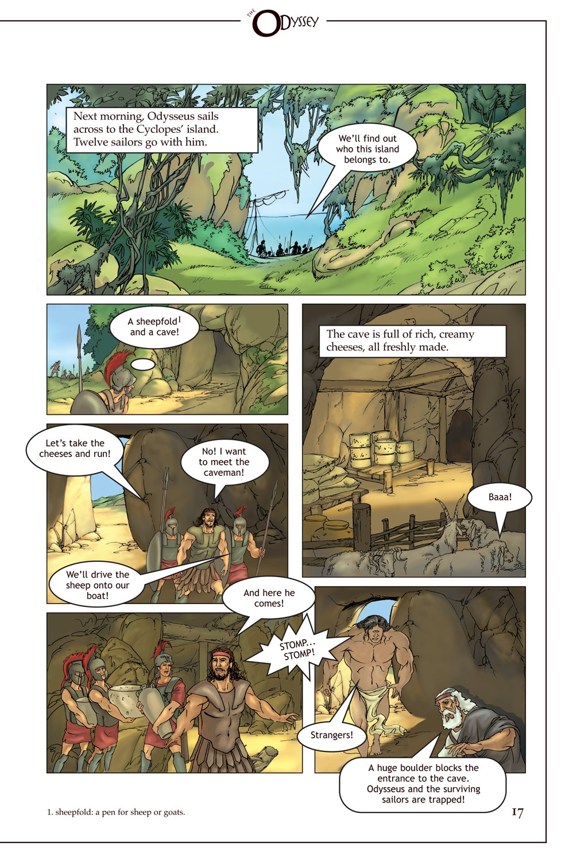

Slide 7
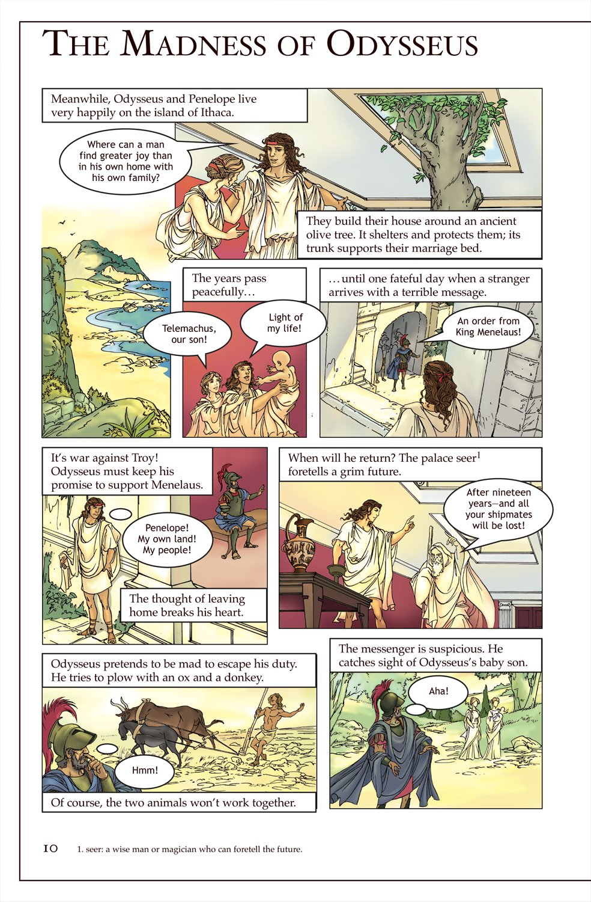
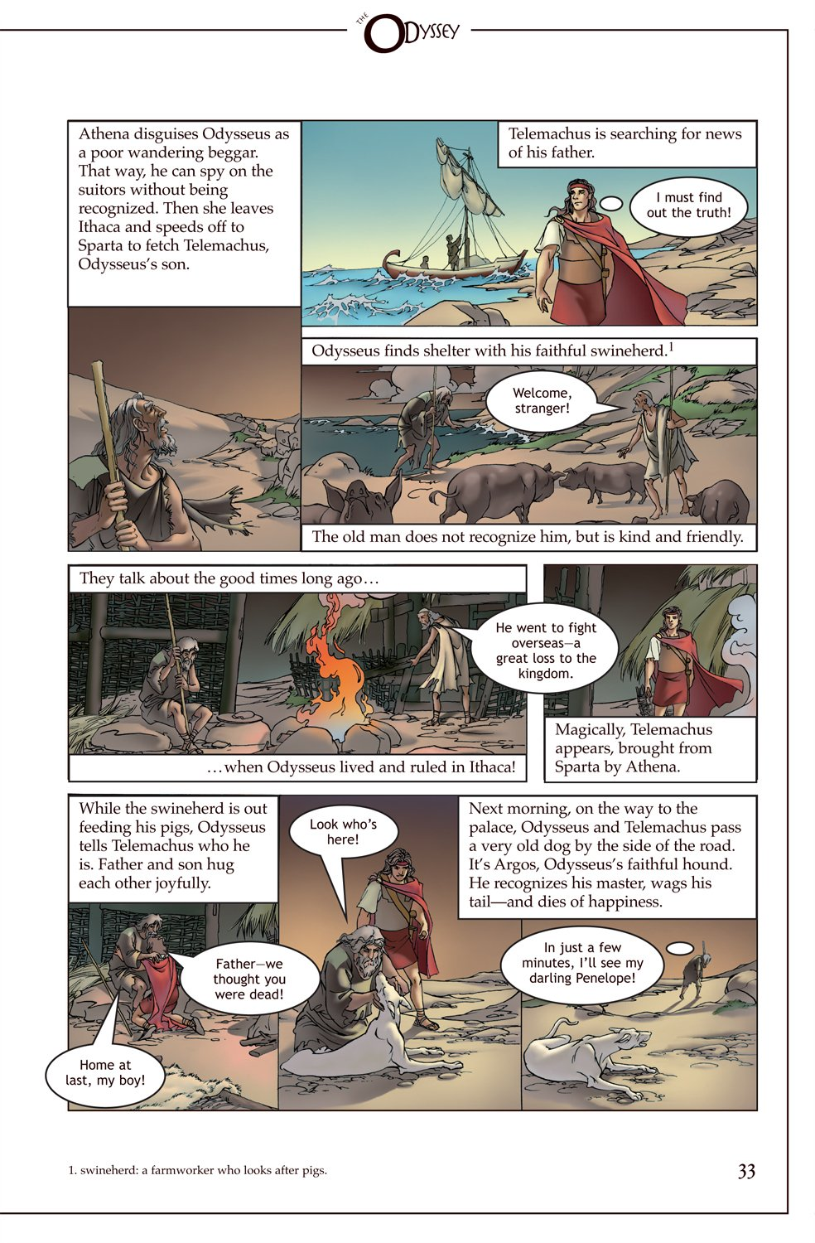

Slide 12
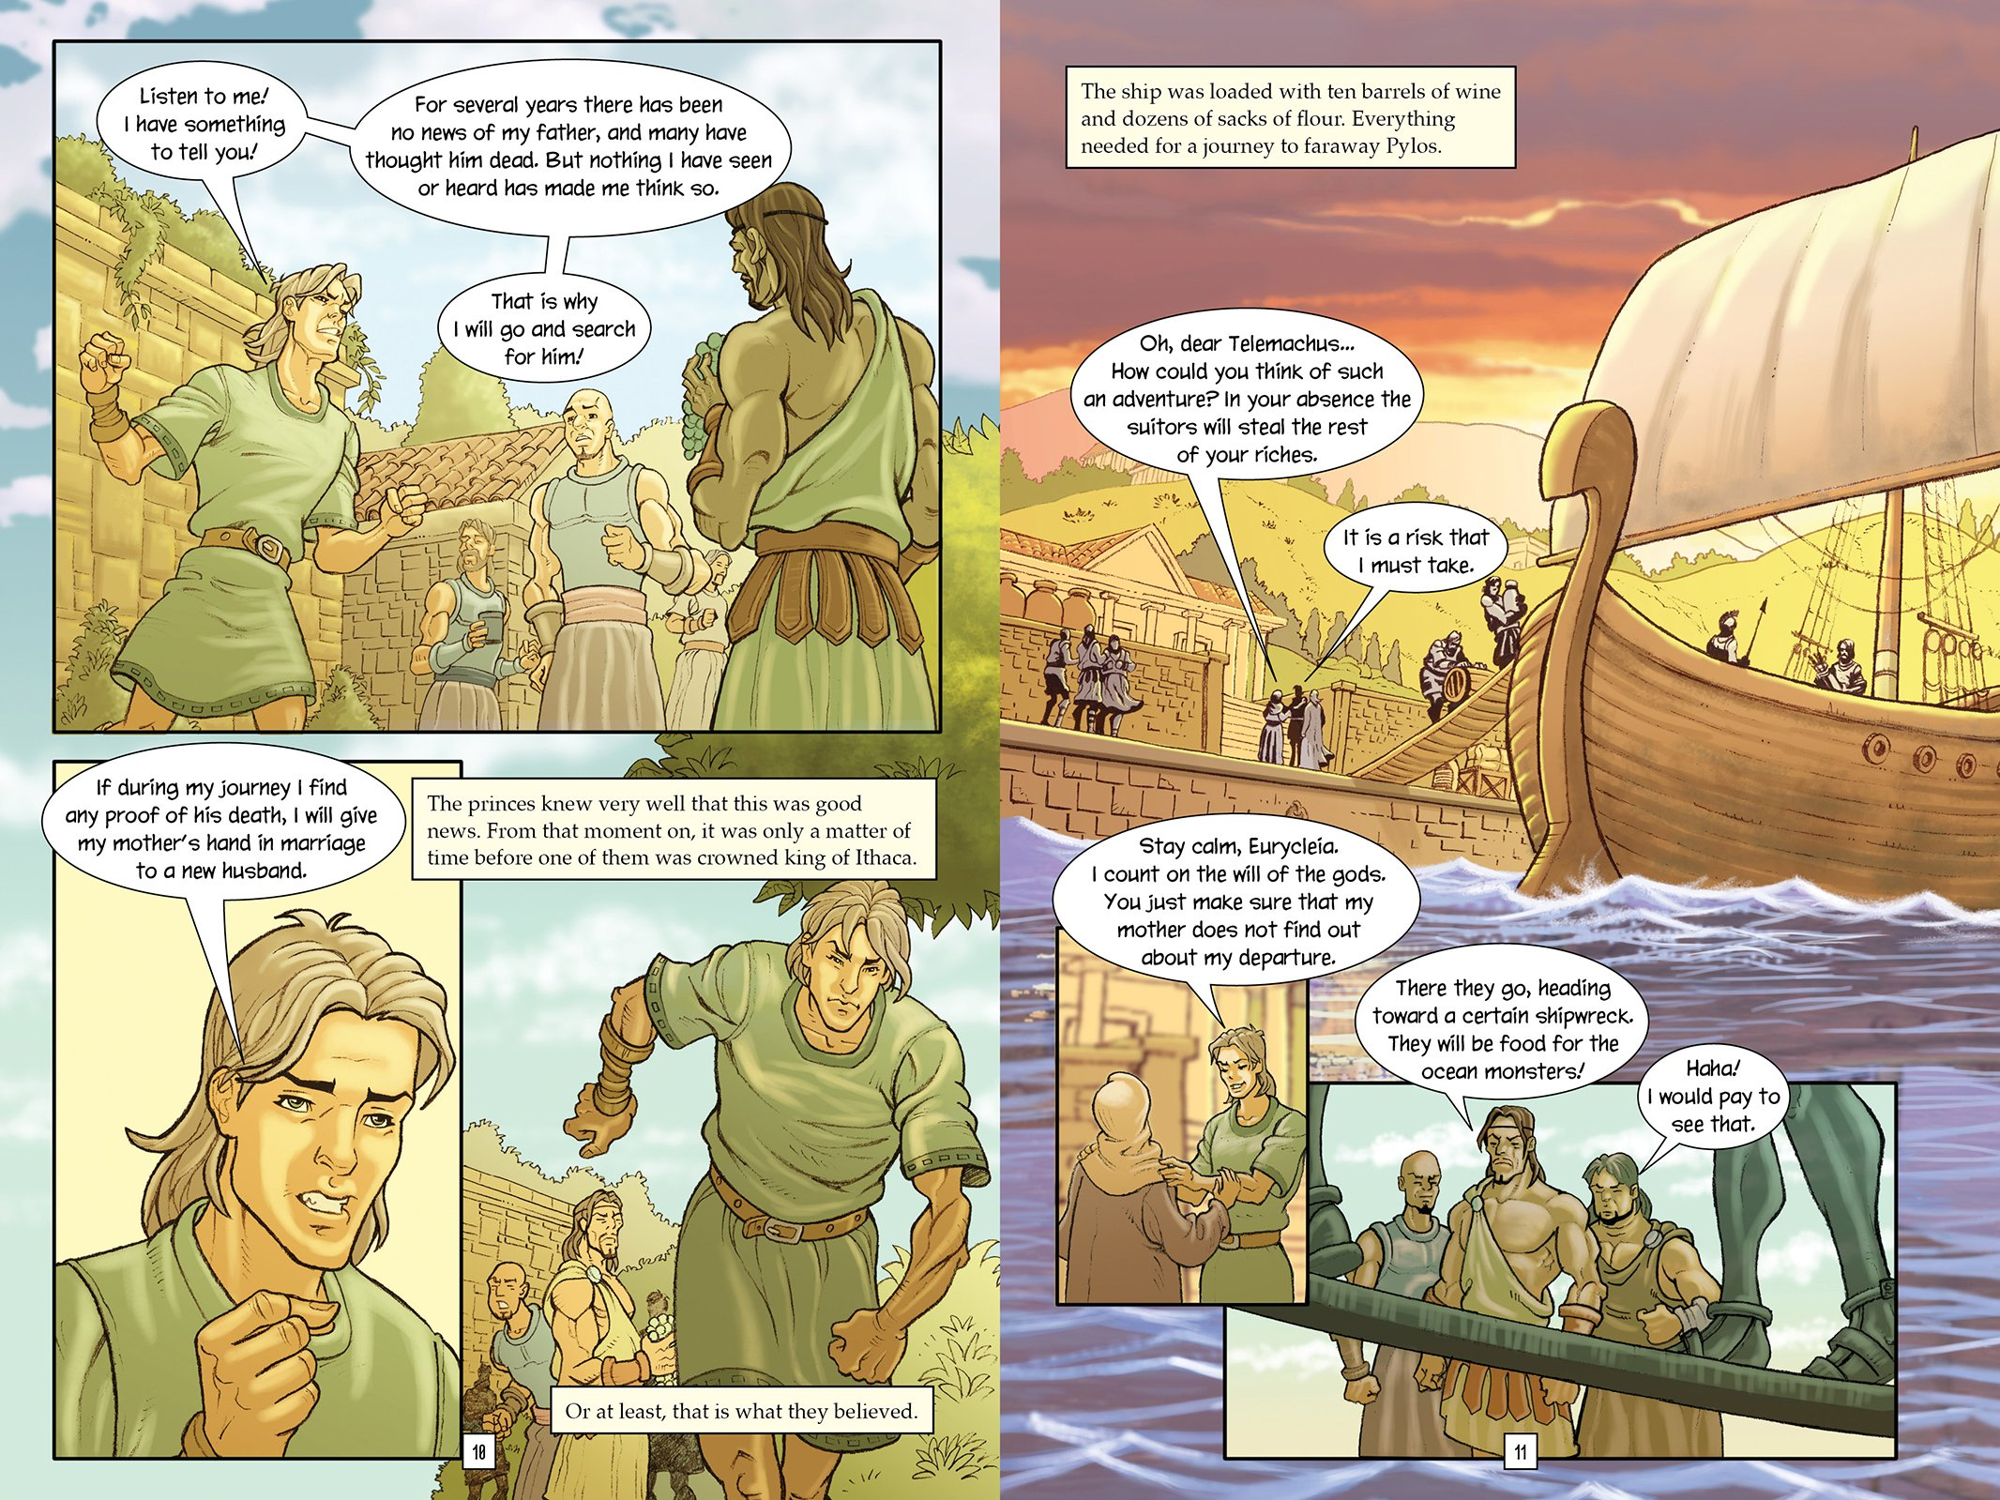

Slide 13
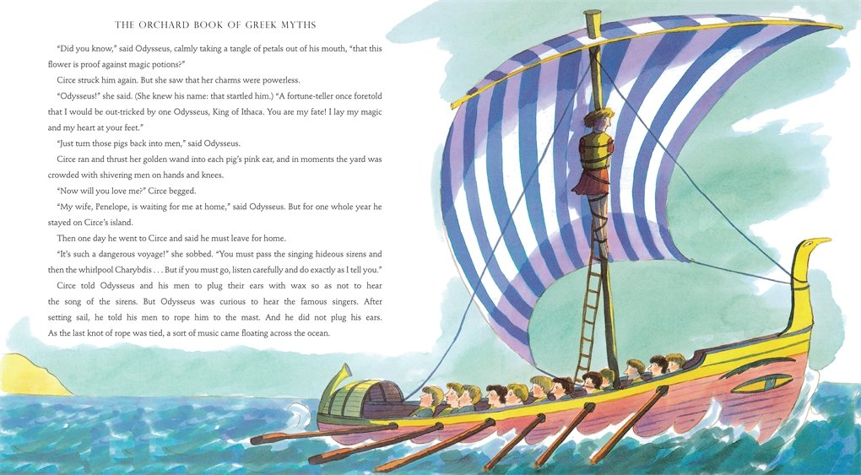

Slide 14
Odysseus the Greek he had 100 men
he sailed them to the end of the world
and he sailed them back again
And when they went South to Sun
A storm sprang up at sea
The ship was wrecked and all his men
Didn’t make it home for tea!

Slide 15
Greek Wordsearch
a | t | h | e | n | s | s | k | l | o
b | g | z | m | j | k | g | p | z | w
s | s | w | q | d | h | r | o | e | a
s | e | a | a | j | k | e | d | u | v
h | m | a | g | r | e | e | k | s | e
e | r | r | o | l | l | c | y | w | s
e | e | e | d | w | z | e | s | o | l
p | h | s | s | h | i | p | s | h | i
h | t | h | e | n | s | s | k | l | o
o | g | z | m | j | k | g | x | z | y
m | d | r | o | w | n | r | a | f | t
e | f | y | a | w | g | h | o | m | e
r | m | k | s | r | u | r | q | n | t
f | p | i | g | s | e | c | a | v | e
d | i | e | r | h | e | e | n | y | x
p | w | r | e | c | k | y | e | m | d
You have 10 minutes to find 24 words

Slide 16
“The journey is the thing.”
“Out of sight,out of mind”
“Too many kings can ruin an army”
“But when he spoke, that great voice of his poured out of his chest in words like the snowflakes of winter.”
Quotes from Homer

Slide 17
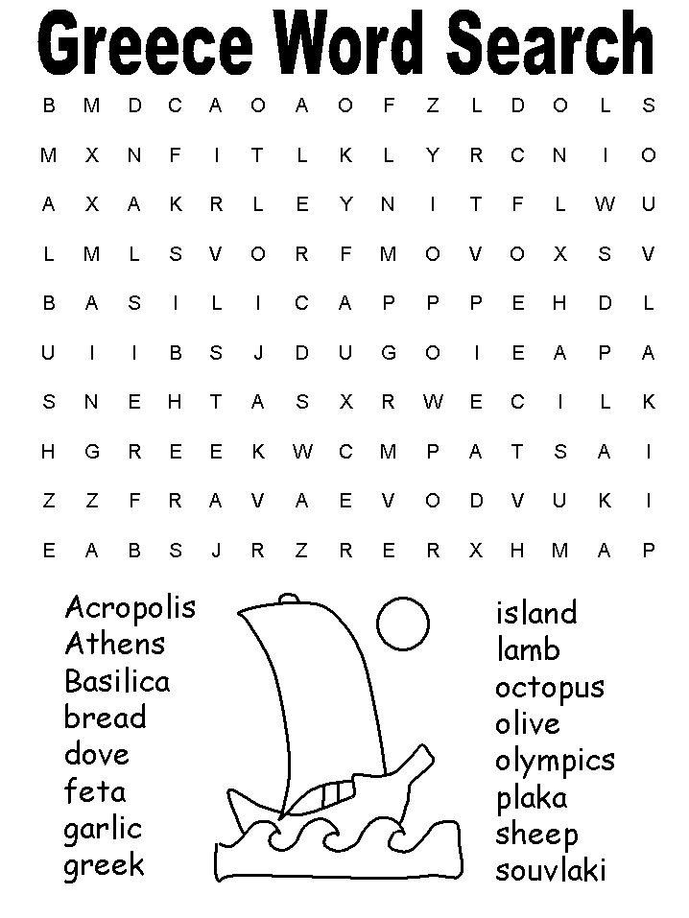

Slide 19
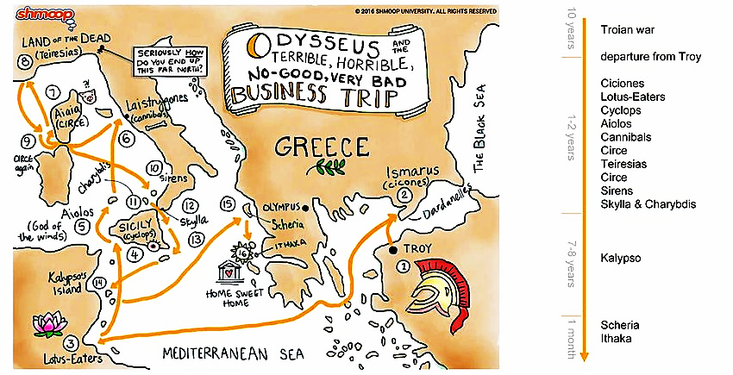

Slide 21
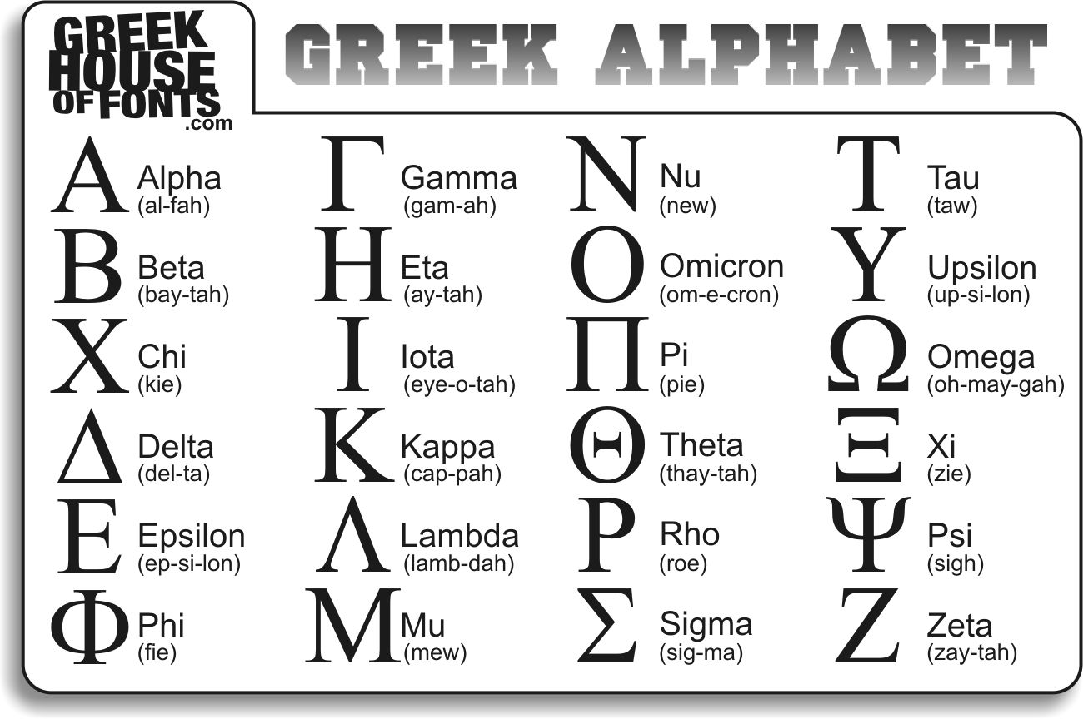
GREEK ALPHABET

Slide 22
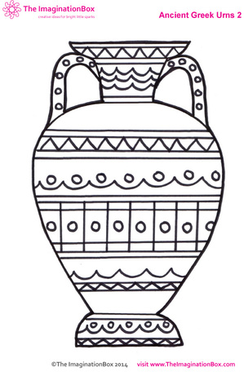
GREEK
VASE
One using two colours
the other multicoloured
The third you can draw
yourself and make your
own patterns.
It must be symmetrical.

Slide 25
How many squares does it take to finish the first Greek pattern?

Slide 26
GREEK PATTERNS
Try making a more complicated
symmetrical, repeating pattern.
You can copy one from the
example sheet if you would
like to or use the same idea.

Slide 28
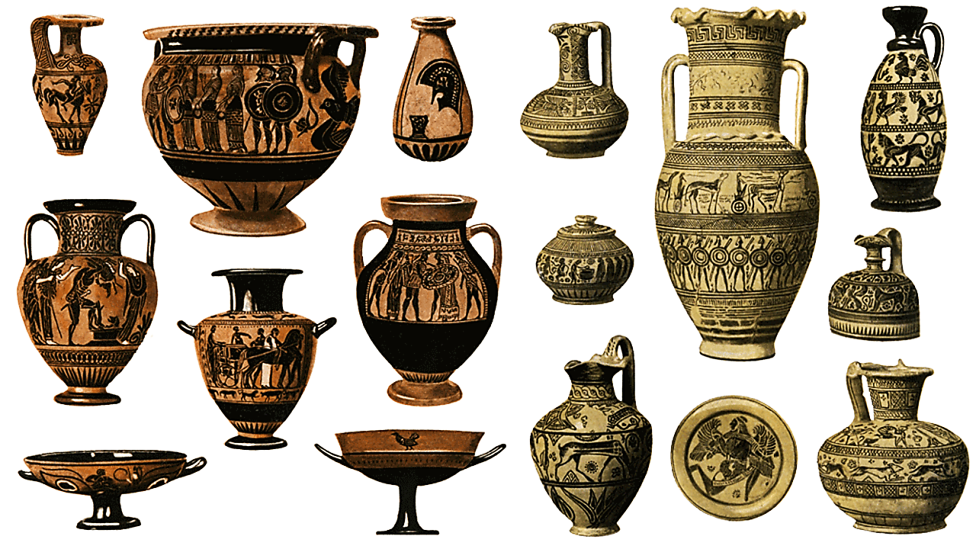

Slide 31
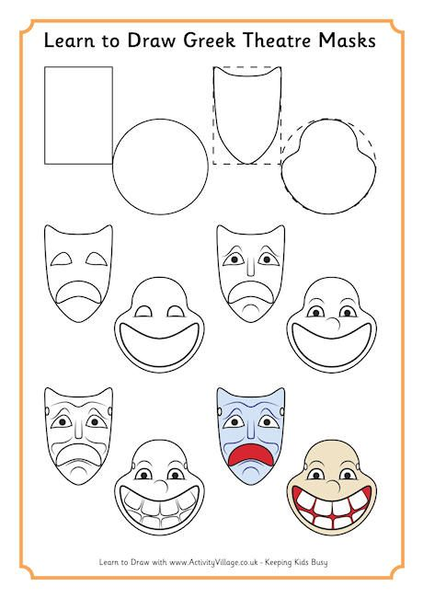

Slide 34
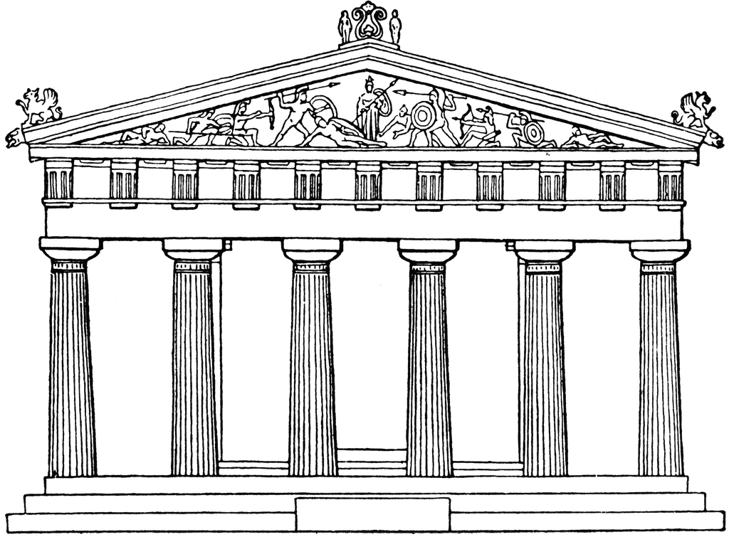

Slide 35
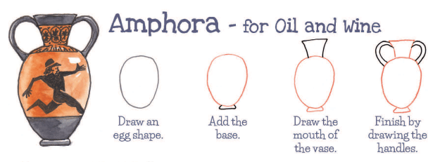
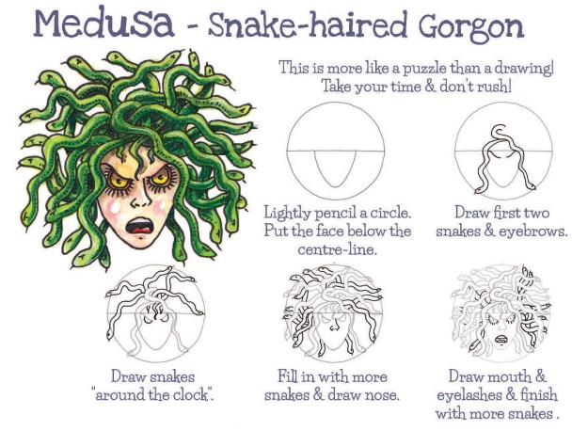
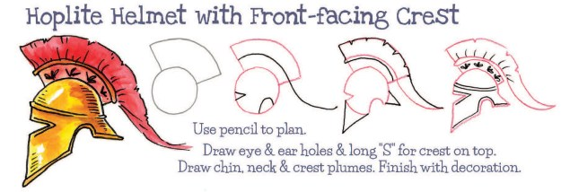

Slide 36
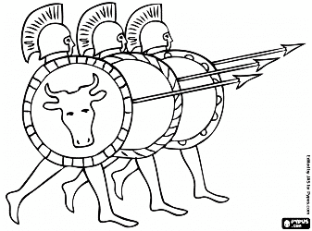

Slide 37
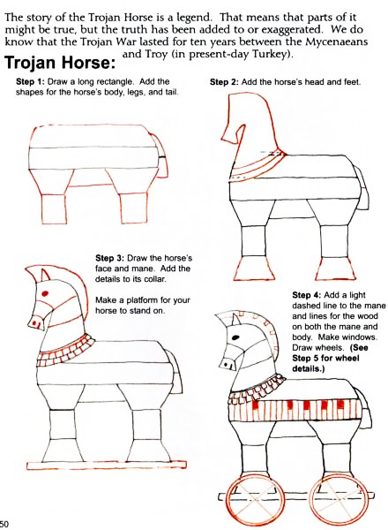
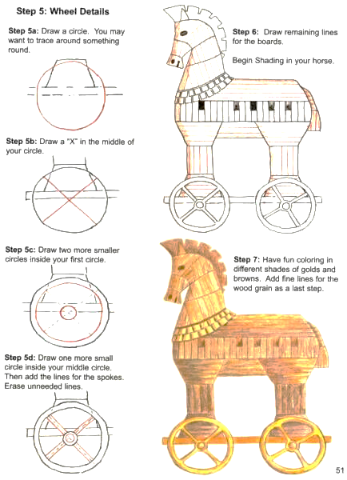

Slide 38
