Slide 1
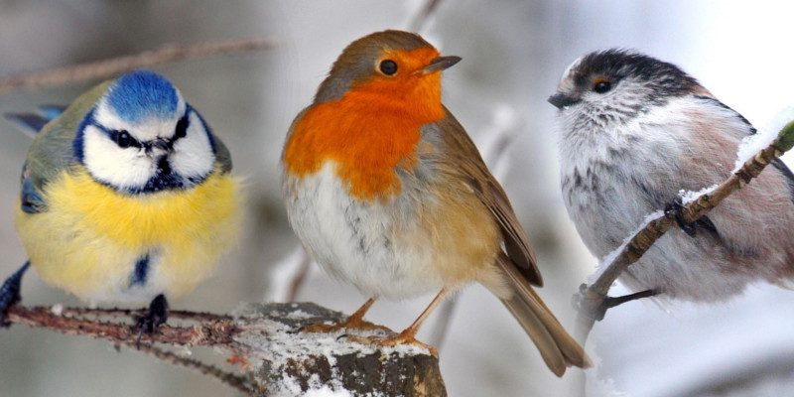
BRITISH GARDEN BIRDS
WVCA
2020

Slide 2
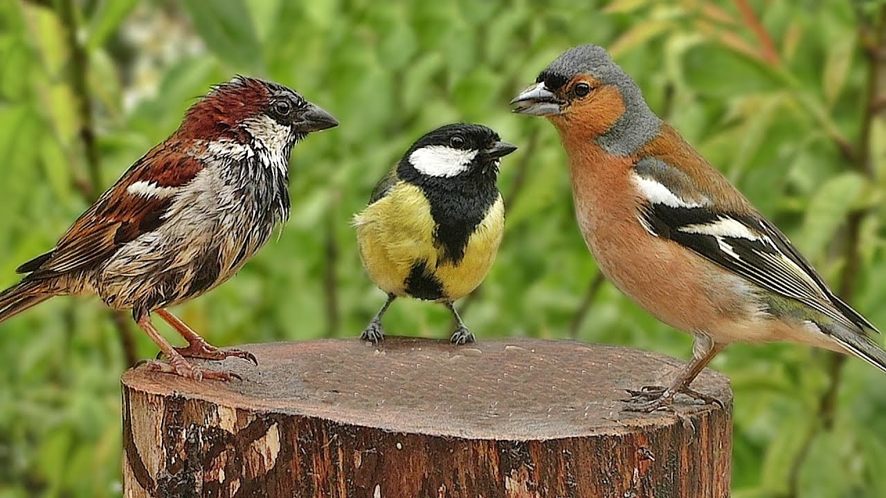
WVCA
2020

Slide 3
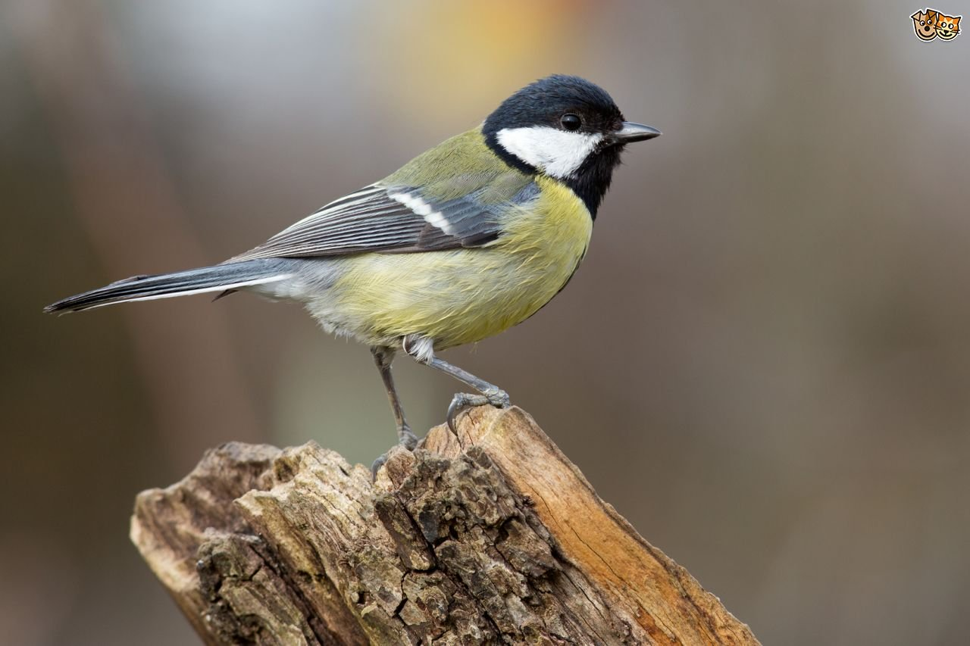
WVCA
2020

Slide 4
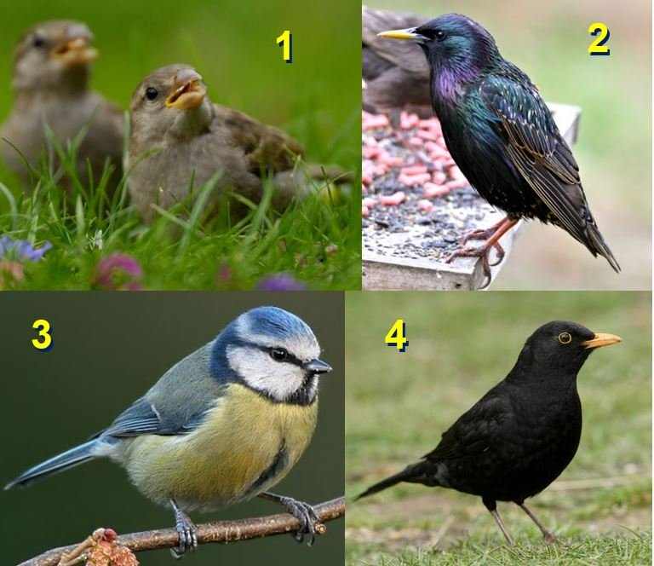
WVCA
2020
?

Slide 5
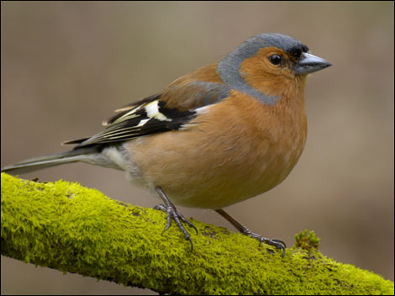
WVCA
2020

Slide 6
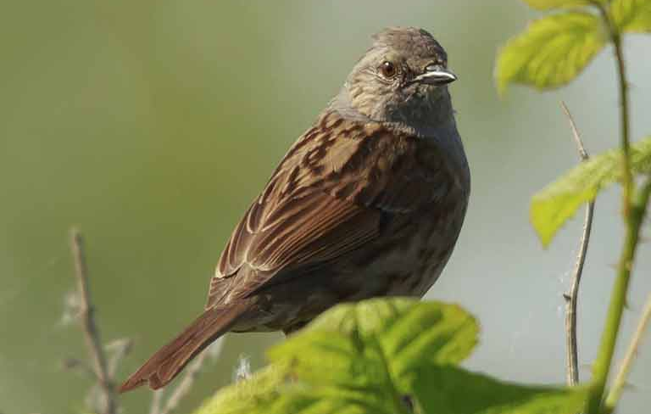
WVCA
2020

Slide 7
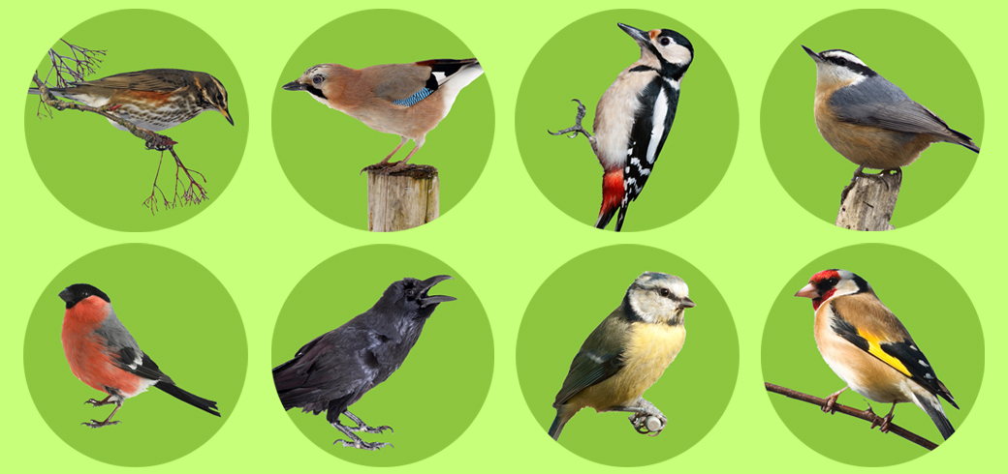
WVCA
2020

Slide 8
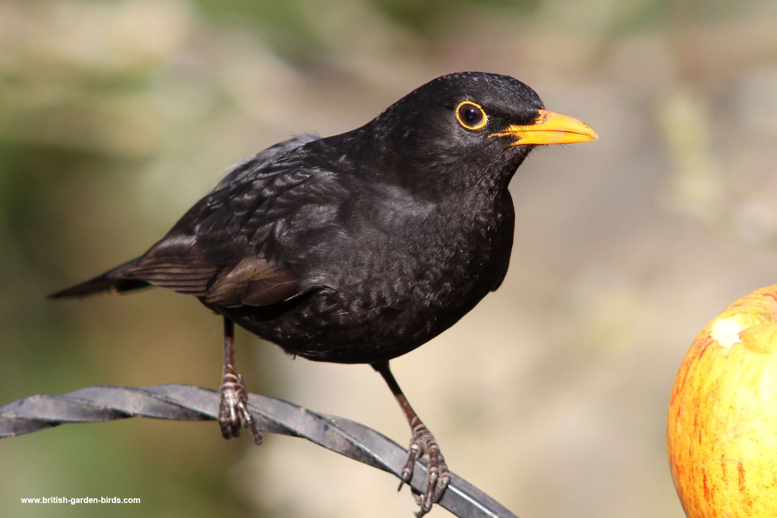
WVCA
2020

Slide 9
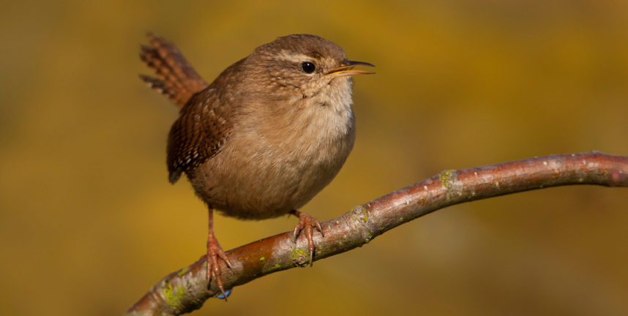
WVCA
2020
Jenny Wren

Slide 10
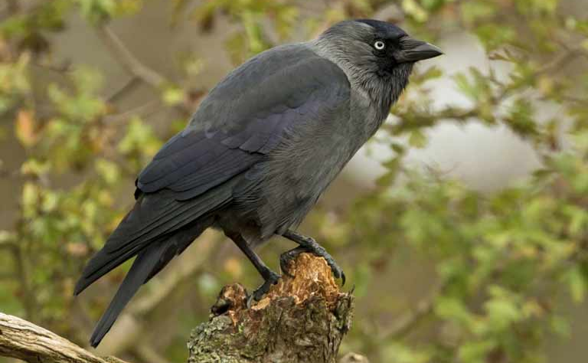
WVCA
2020

Slide 11
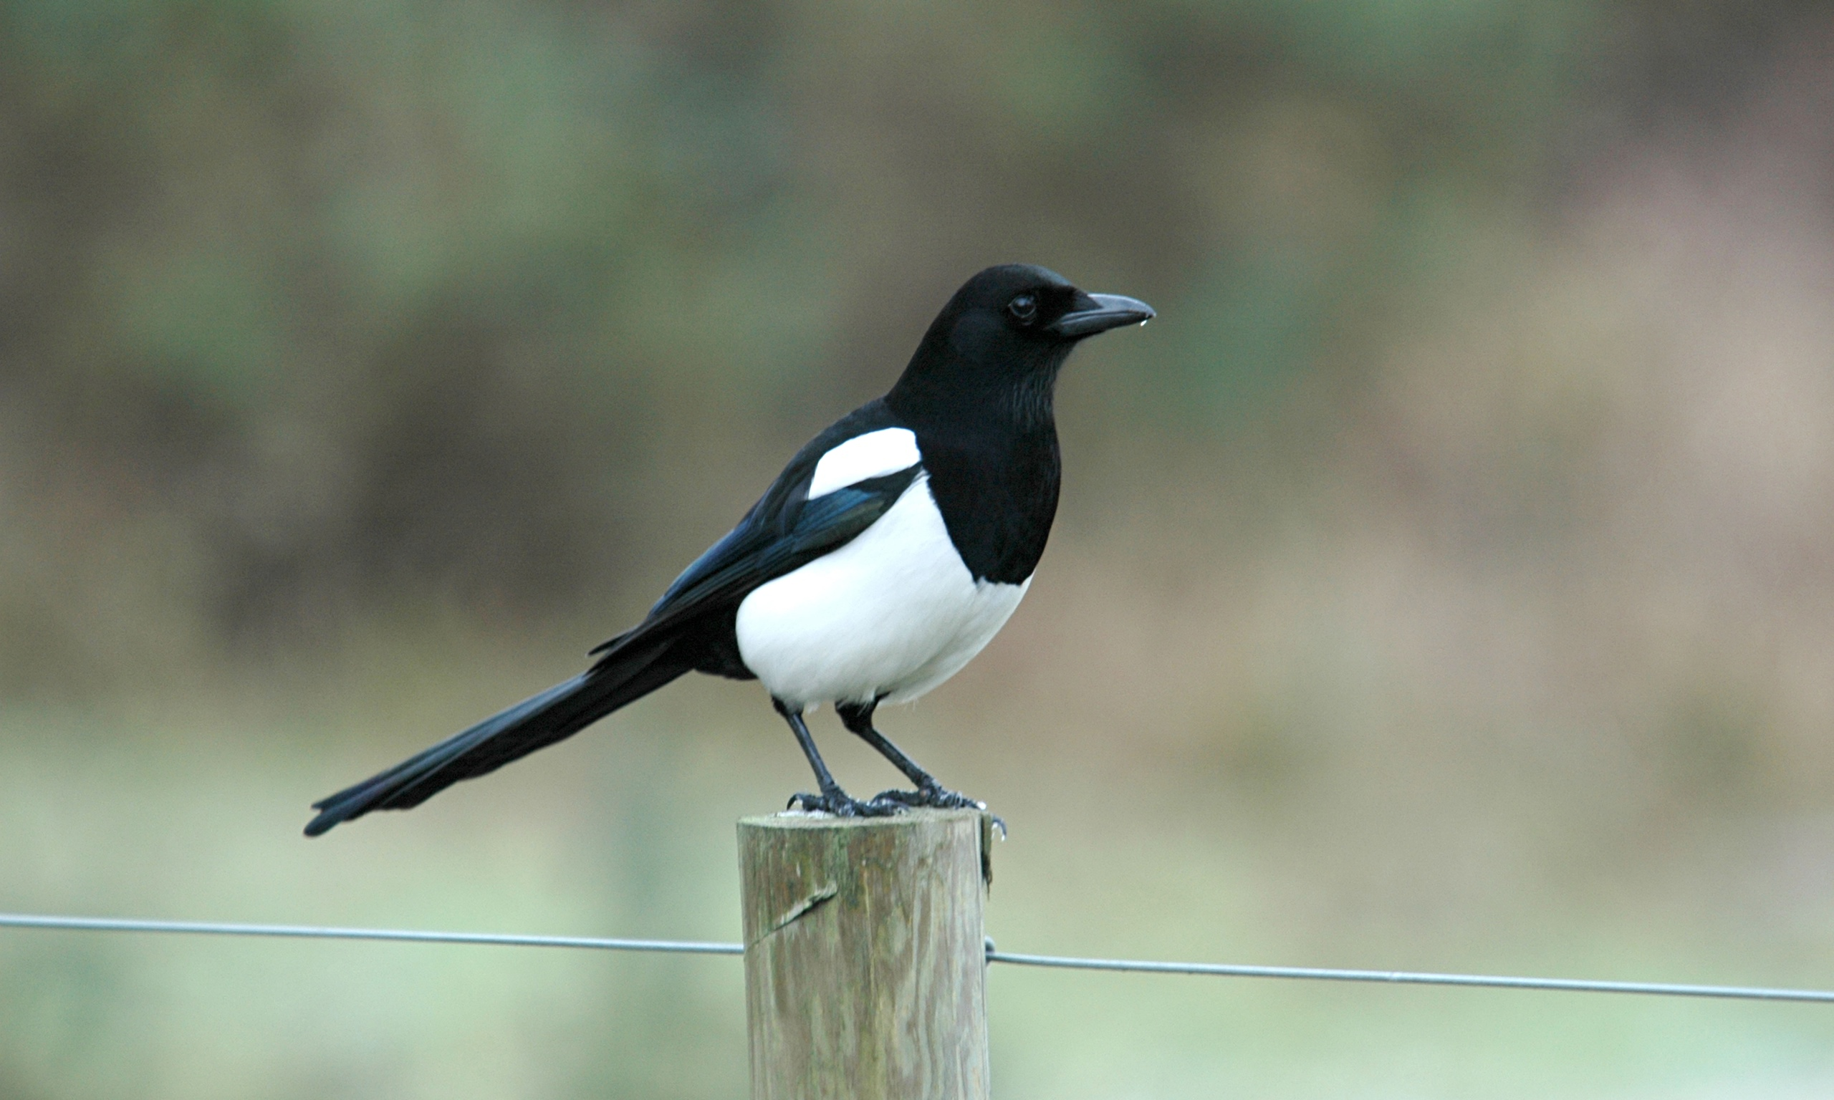
WVCA
2020

Slide 12
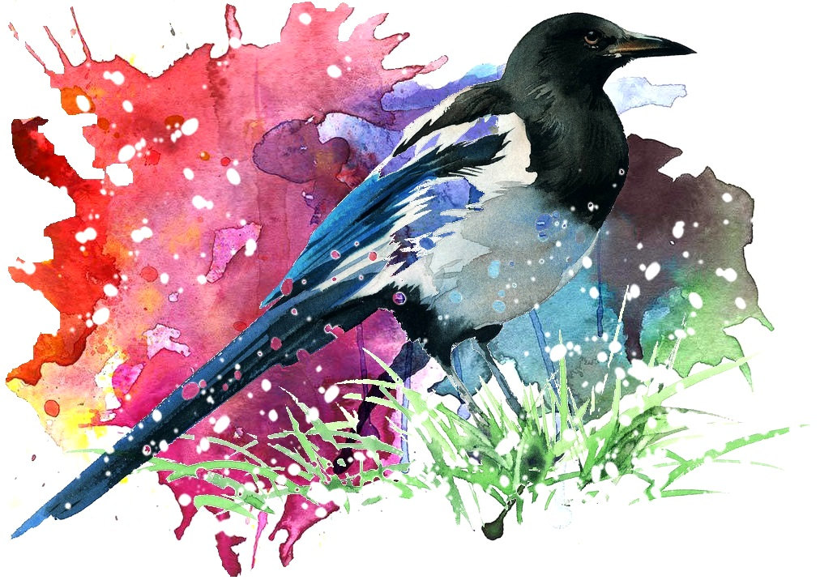
WVCA
2020

Slide 13
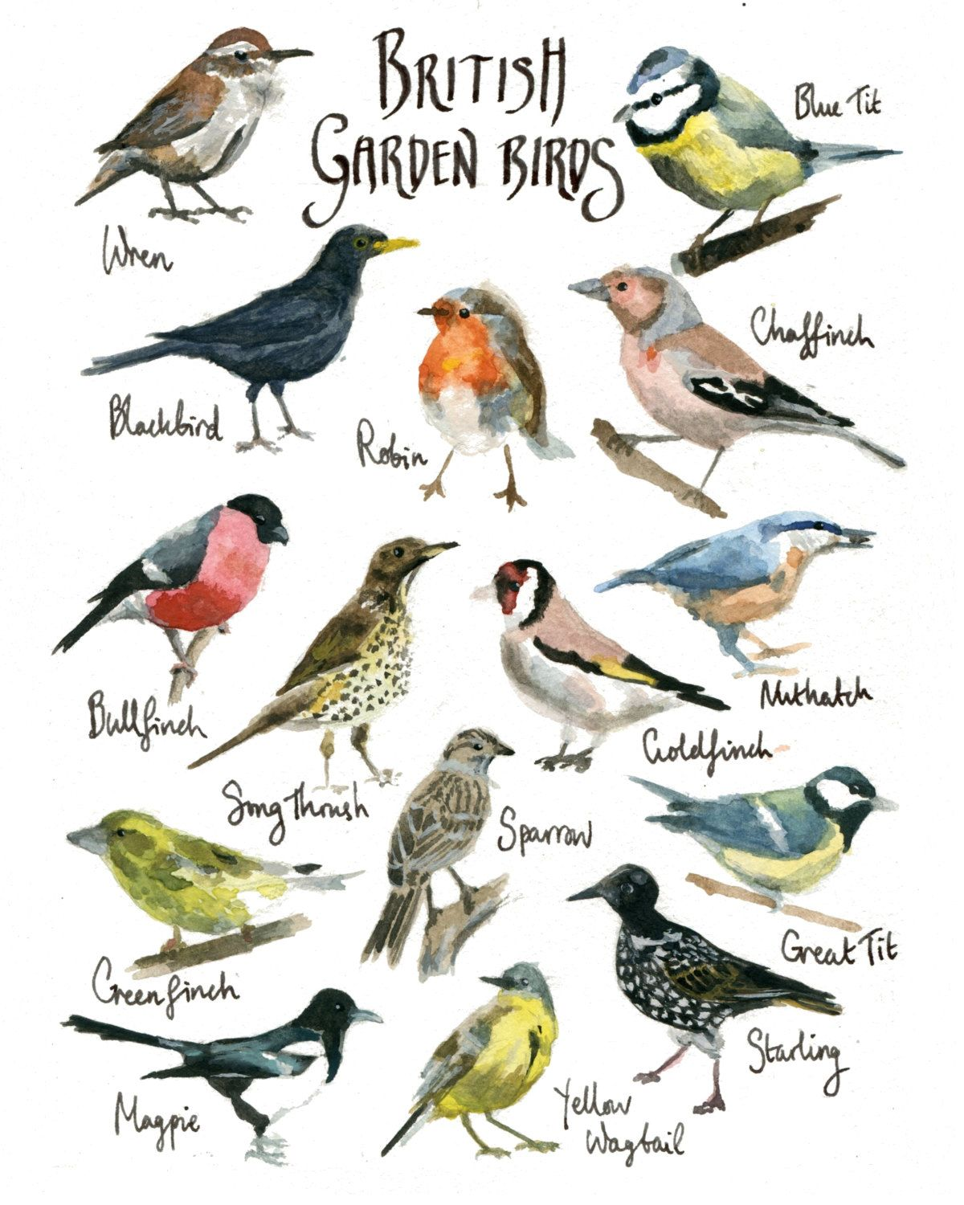
WVCA
2020

Slide 14
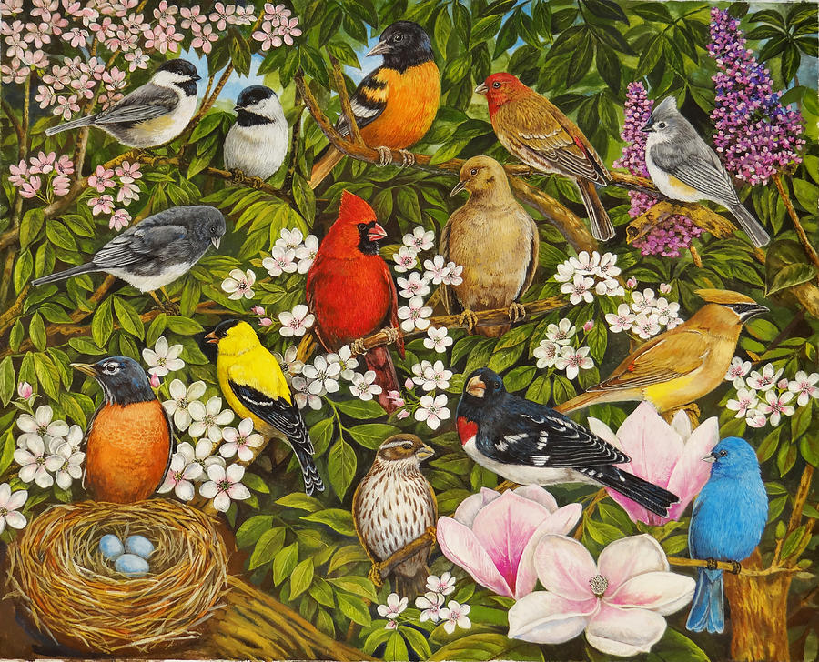
WVCA
2020

Slide 15
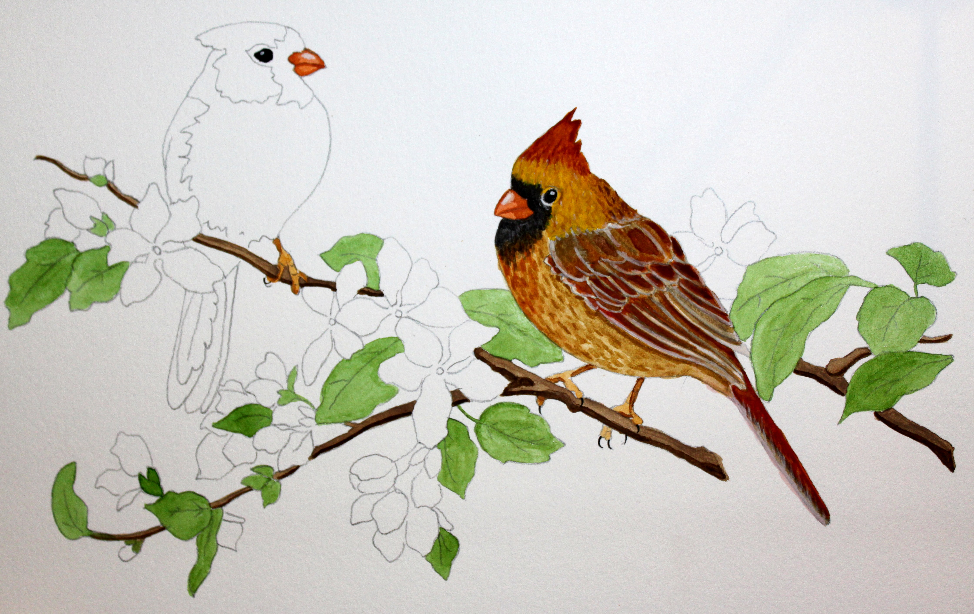
WVCA
2020

Slide 16
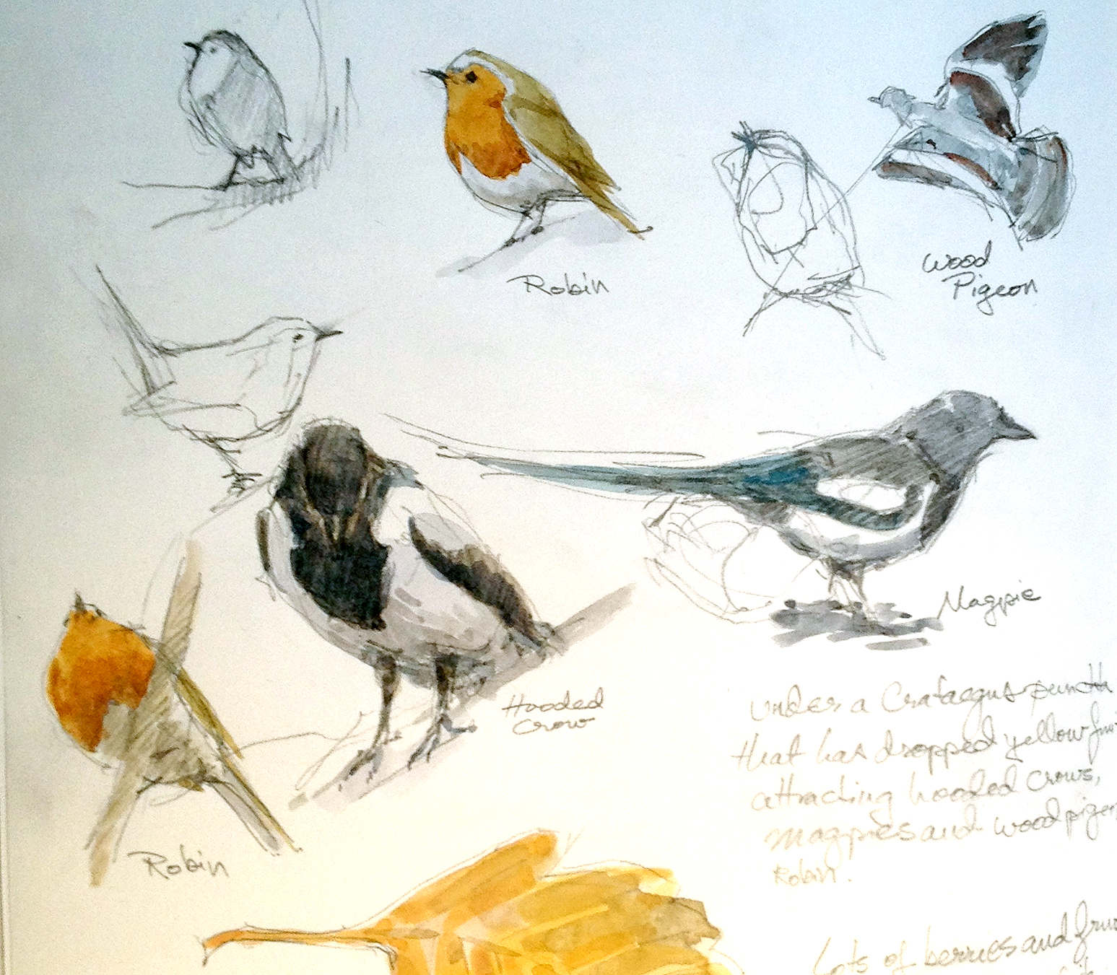
WVCA
2020

Slide 17
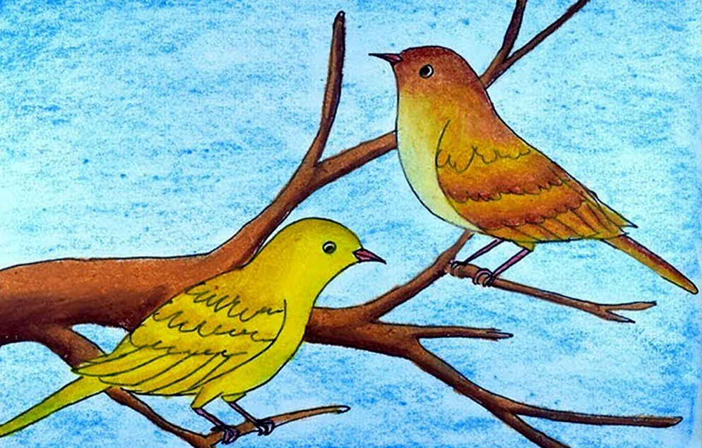
WVCA
2020

Slide 18
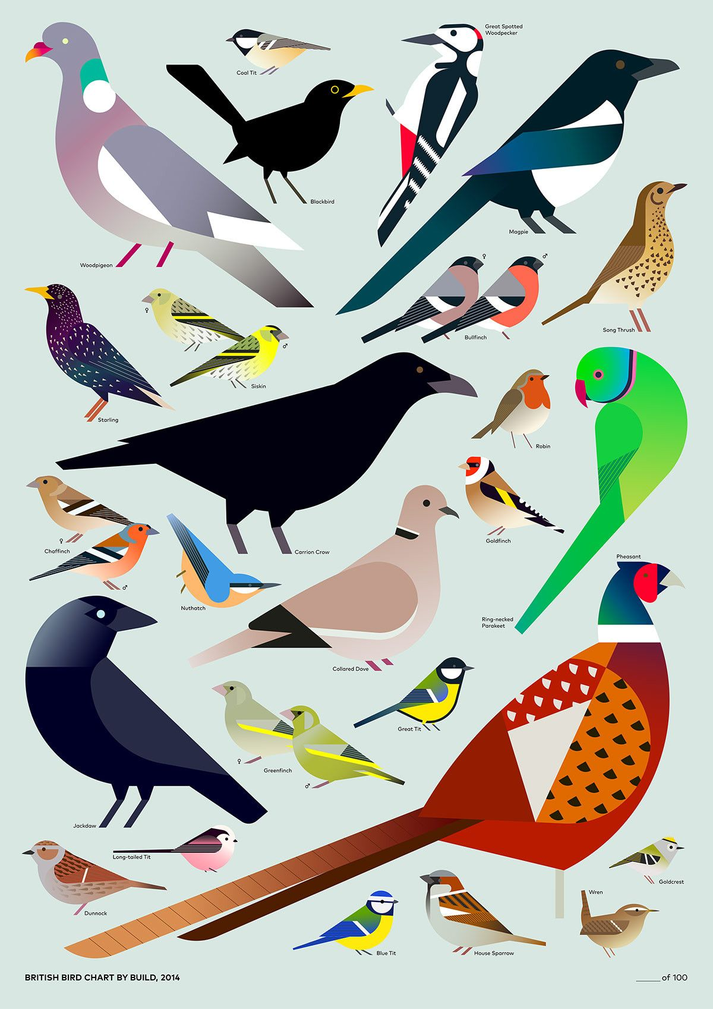
WVCA
2020

Slide 19
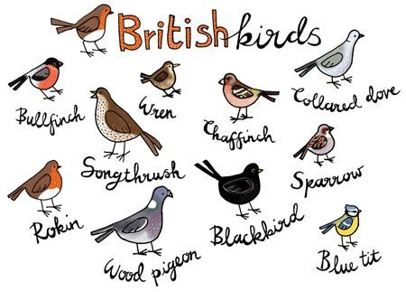
WVCA
2020

Slide 20
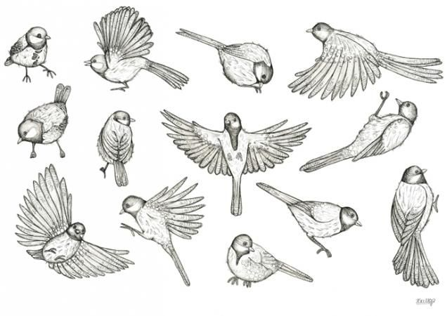
WVCA
2020

Slide 21
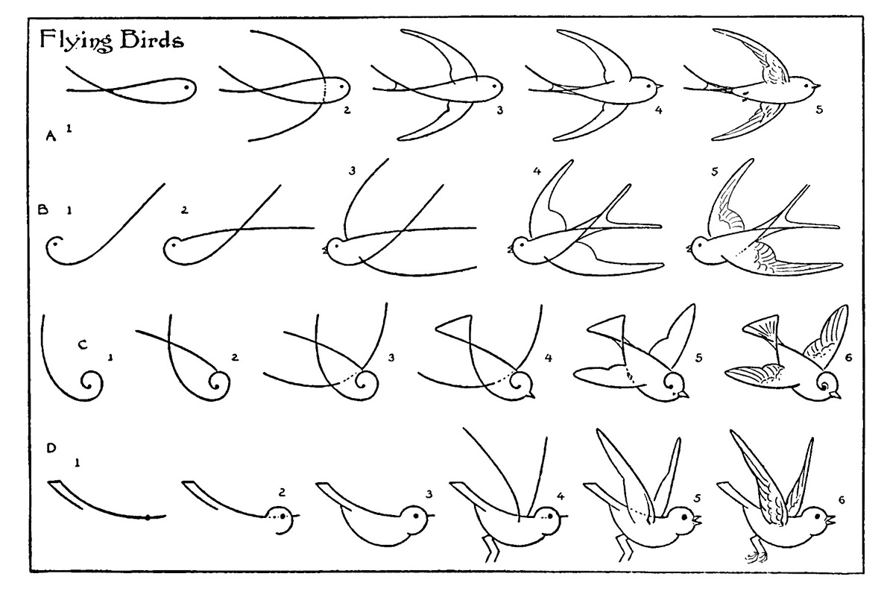
WVCA
2020

Slide 22
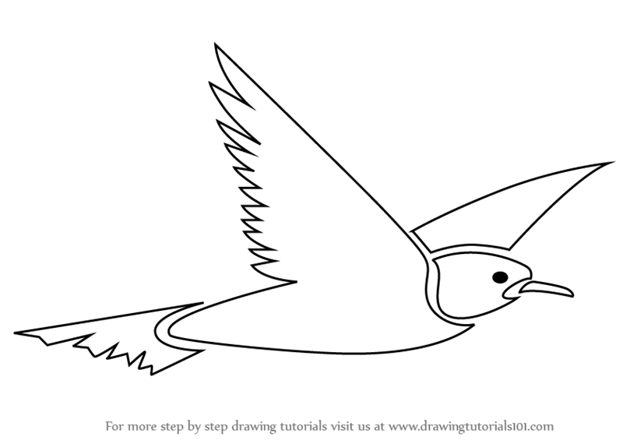
WVCA
2020

Slide 23
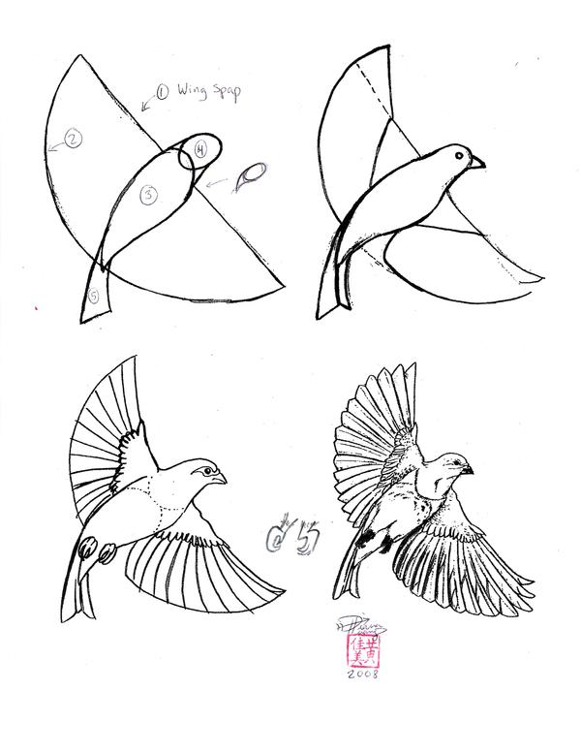
WVCA
2020

Slide 24
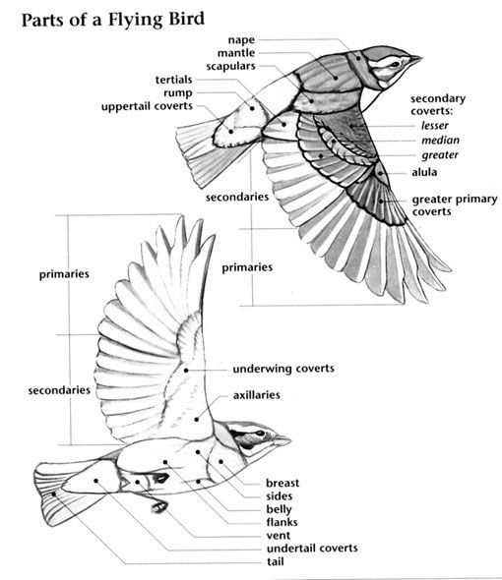
WVCA
2020

Slide 25
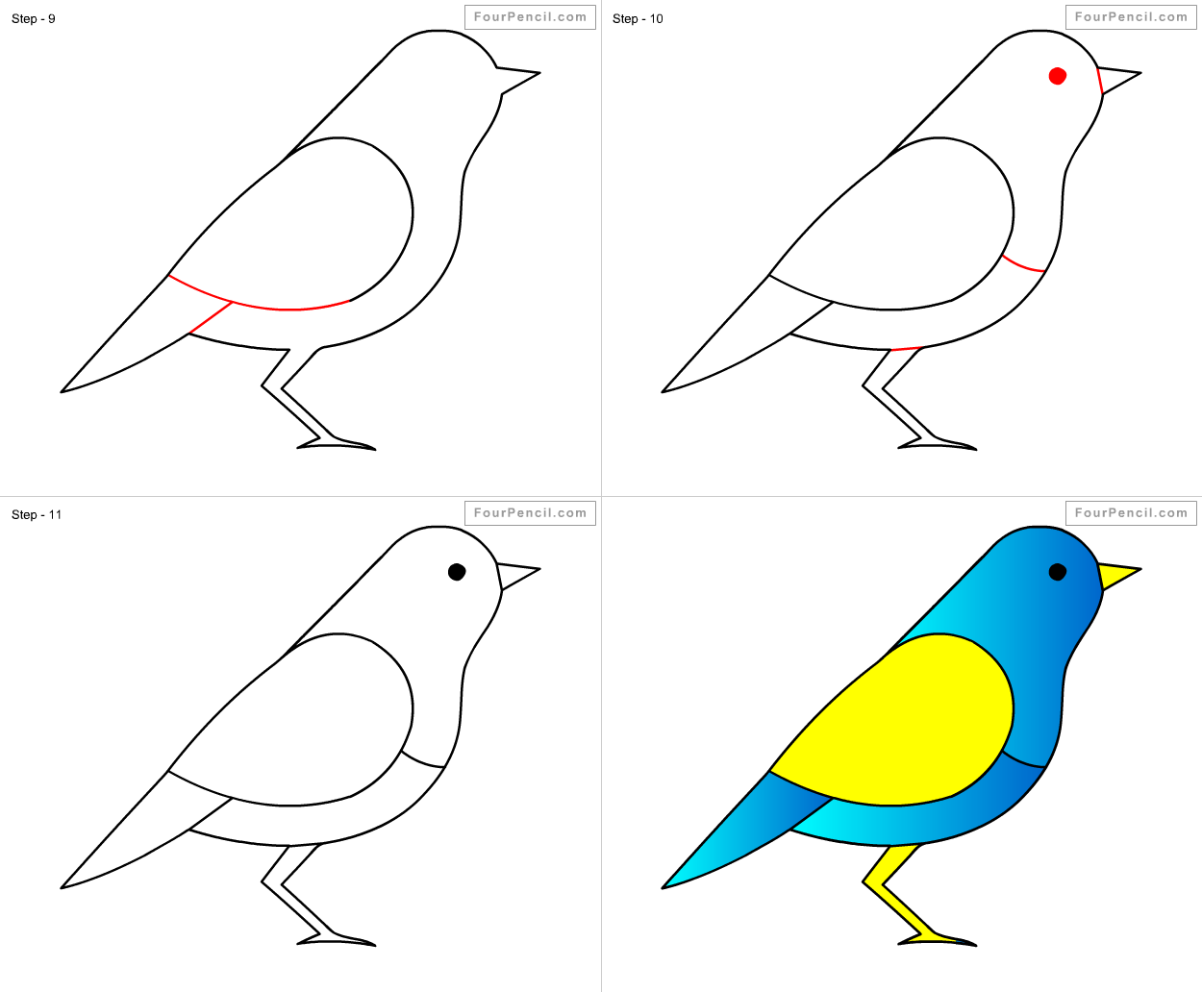
WVCA
2020

